Slide 1
Interactions

Slide 2
An interaction is a behavior that comprises a set of messages exchanged among a set of objects within a context to accomplish a purpose. A message is a specification of a communication between objects.

Slide 3
Sequence Number
message
1:1getLastCheckPoint
1:getPositionAtTime(t)
t:AirTrafficPlanner
P:FlightPlan
link
object
Messages, links, Sequencing
You use interactions to model the flow of control within an operation, a class, component, use case, or the system as a whole.

Slide 4
In the UML, you model the dynamic aspects of the system by using interactions.
Context
We may find an interaction wherever objects are linked to
one another.
We will also find interactions in the context of an operation.
Finally, you'll find interactions in the context of a class.

Slide 5
objects and roles
The objects that participate in an interaction are either concrete things or prototypical things.
As a concrete thing, an object represents something in the real world. For example, p, an instance of the class Person, might denote a particular human.
As a prototypical thing, p might represent any instance of Person.

Slide 6
Links
A link is a semantic connection among objects. In general, a link is an instance of an association.
Wherever a class has an association to another class, there may be a link between the instances of the two classes. Wherever there is a link between two objects, one object can send a message to the other object.
A link specifies a path along which one object can dispatch a message to another (or the same) object.

Slide 7
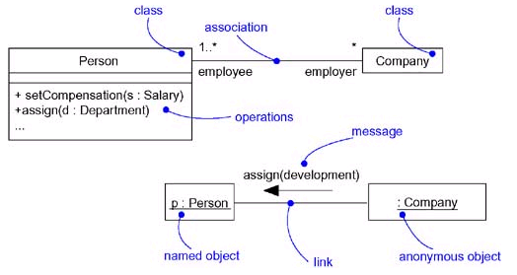
Links and associations

Slide 8
We can adorn the appropriate end of the link with any
of the following standard stereotypes
association | Specifies that the corresponding object is visible by association
self | Specifies that the corresponding object is visible because it is the dispatcher of the operation
global | Specifies that the corresponding object is visible because it is in an enclosing scope
local | Specifies that the corresponding object is visible because it is in a local scope
parameter | Specifies that the corresponding object is visible because it is a parameter

Slide 9
Messages
A message is the specification of a communication among objects.
The receipt of a message instance may be considered an instance of an event.
When you pass a message, the action that results is an executable statement.

Slide 10
In the UML, you can model several kinds of actions
Call | Invokes an operation on an object; an object may send a message to itself, resulting in the local invocation of an operation
Return | Returns a value to the caller
Send | Sends a signal to an object
Create | Creates an object
Destroy | Destroys an object; an object may commit suicide by destroying itself

Slide 11
The UML provides a visual distinction among these kinds of messages
messages

Slide 12
Sequencing
When an object passes a message to another object the receiving object might in turn send a message to another object, which might send a message to yet a different object, and so on. This stream of messages forms a sequence.
Any sequence must have a beginning; the start of every sequence is rooted in some process or thread.
Any sequence will continue as long as the process or thread that owns it lives.
Messages are ordered in sequence by time. To better visualize the sequence of a message, you can explicitly model the order of the message relative to the start of the sequence by prefixing the message with a sequence number set apart by a colon separator.

Slide 13
Most commonly, you can specify a procedural or nested flow of control, rendered using a filled solid arrowhead
Procedural sequence

Slide 14
We can specify a flat flow of control, rendered using a stick arrowhead, to model the nonprocedural progression of control from step to step.
Flat Sequence
We'll want to use procedural sequences, because they represent ordinary, nested operation calls of the type you find in most programming languages.

Slide 15
When you are modeling interactions that involve multiple flows of control, it’s especially important to identify the process or thread that sent a particular message. In the UML you can distinguish one flow of control from another by prefixing a messages sequence number with the name of the process or thread that sits at the root of the sequence.
D5 : ejectHatch(3)
specifies that the operation ejectHatch is dispatched (with the actual argument 3) as the fifth message in the sequence rooted by the process or thread named D .
you can show the return values of a function as well. As the following expression shows, the value p is returned from the operation find, dispatched with the actual parameter "Rachelle". This is a nested sequence, dispatched as the second message nested in the third message nested in the first message of the sequence. In the same diagram, p can then be used as an actual parameter in other messages.
1.3.2 : p := find("Rachelle")

Slide 16
Creation, Modification, and Destruction
Most of the time, the objects you show participating in an interaction exist for the entire duration of the interaction. However, in some interactions, objects may be created (specified by a create message) and destroyed (specified by a destroy message).
The same is true of links: the relationships among objects may come and go. To specify if an object or link enters and/or leaves during an interaction, you can attach one of the following constraints to the element:
new | Specifies that the instance or link is created during execution of the enclosing interaction
destroyed | Specifies that the instance or link is destroyed prior to completion of execution of the enclosing interaction
transient | Specifies that the instance or link is created during execution of the enclosing interaction but is destroyed before completion of execution

Slide 17
Representation
When you model an interaction, you typically include both objects and messages
We can visualize those objects and messages involved in an interaction in two ways
By emphasizing the time ordering of its messages
by emphasizing the structural organization of the objects that send and receive messages.
In the UML, the first kind of representation is called a sequence diagram
The second kind of representation is called a collaboration diagram
Both sequence diagrams and collaboration diagrams are kinds of interaction diagrams
Sequence diagrams and collaboration diagrams are largely isomorphic.
Sequence diagrams permit you to model the lifeline of an object.
Collaboration diagrams permit you to model the structural links that may exist among the objects in an interaction.

Slide 18
Common modeling techniques Modeling a Flow of Control
The most common purpose for which you'll use interactions is to model the flow of control that characterizes the behavior of a system as a whole, including use cases, patterns, mechanisms, and frameworks, or the behavior of a class or an individual operation.
To model a flow of control
Set the context for the interaction, whether it is the system as a whole, a class, or an individual operation.
Set the stage for the interaction by identifying which objects play a role; set their initial properties, including their attribute values, state, and role.

Slide 19
If your model emphasizes the structural organization of these objects, identify the links that connect them, relevant to the paths of communication that take place in this interaction. Specify the nature of the links using the UML's standard stereotypes and constraints, as necessary.
In time order, specify the messages that pass from object to object. As necessary, distinguish the different kinds of messages; include parameters and return values to convey the necessary detail of this interaction.

Slide 20
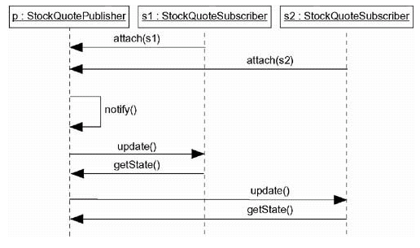
This figure is an example of a sequence diagram, which emphasizes the time order of messages.
Publish and subscribe mechanism
Flow of control by Time

Slide 21
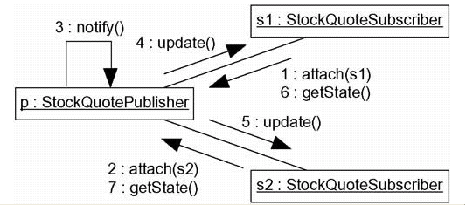
This figure is semantically equivalent to the previous one, but it is drawn as a collaboration diagram, which emphasizes the structural organization of the objects.
Flow of Control by Organization

Slide 22
Chapter-18 Interaction Diagrams

Slide 23
Ch-18 Interaction Diagrams
Sequence diagrams and collaboration diagrams- both of which are called interaction diagrams used in the UML for modeling the dynamic aspects of systems.

Slide 24
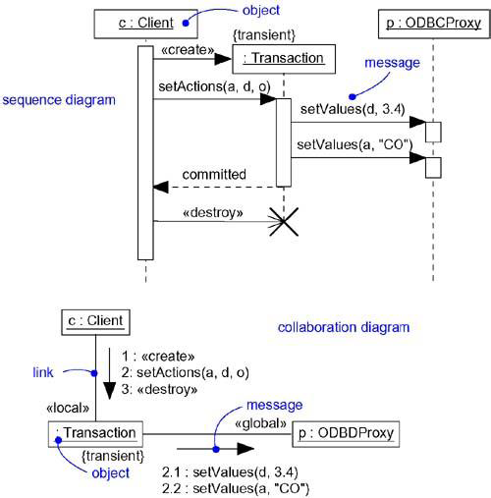
Interaction Diagrams

Slide 25
An interaction diagram shows an interaction, consisting of a set of objects and their relationships, including the messages that may be dispatched among them.
A sequence diagram is an interaction diagram that emphasizes the time ordering of messages.

Slide 26
A collaboration diagram is an interaction diagram that emphasizes the structural organization of the objects that send and receive messages.

Slide 27
Interaction diagrams commonly contain
Objects
Links
Messages
Like all other diagrams, interaction diagrams may contain notes and constraints.

Slide 28
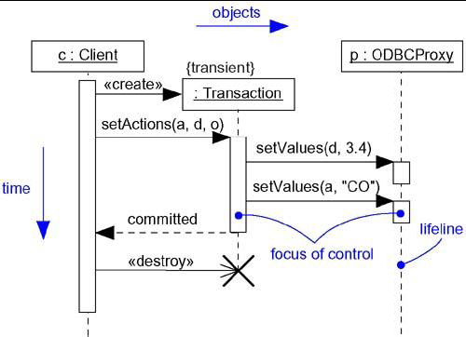
Sequence Diagrams

Slide 29
Sequence Diagrams
A sequence diagram emphasizes the time ordering of messages.
As Figure shows, you form a sequence diagram by first placing the objects that participate in the interaction at the top of your diagram, across the X axis.
Typically, you place the object that initiates the interaction at the left, and increasingly more subordinate objects to the right.

Slide 30
Next, you place the messages that these objects send and receive along the Y axis, in order of increasing time from top to bottom.

Slide 31
Lifeline:- An object lifeline is the vertical dashed line that represents the existence of an object over a period of time.
Objects may be created during the interaction. Their lifelines start with the receipt of the message stereotyped as create. Objects may be destroyed during the interaction. Their lifelines end with the receipt of the message stereotyped as destroy (and are given the visual cue of a large X, marking the end of their lives).

Slide 32
Focus of control:- The focus of control is a tall, thin rectangle that shows the period of time during which an object is performing an action.
The top of the rectangle is aligned with the start of the action; the bottom is aligned with its completion (and can be marked by a return message).

Slide 33
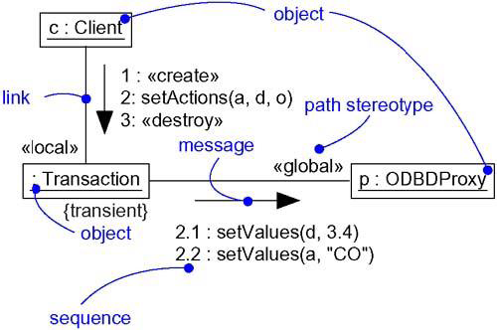
Collaboration Diagrams

Slide 34
Collaboration Diagrams
A collaboration diagram emphasizes the organization of the objects that participate in an interaction.
As Figure shows, you form a collaboration diagram by first placing the objects that participate in the interaction as the vertices in a graph.

Slide 35
Next, you render the links that connect these objects as the arcs of this graph.

Slide 36
UNIT-5
CHAPTER-16

Slide 37
Introduction
Use cases, actors, include, and extend
Modeling the behavior of an element
Realizing use cases with collaborations

Slide 38
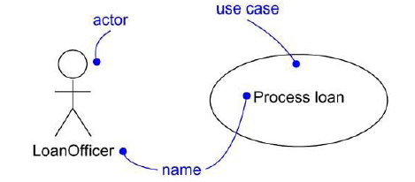
Use Cases : Terms and Concepts
UseCase : A use case is a description of a set of sequences of actions, including variants, that a system performs to yield an observable result of value to an actor. Graphically, a use case is rendered as an ellipse.
Ex: Process Loan
Actor : An actor represents a coherent set of roles that users of use cases play when interacting with these use cases. Typically, an actor represents a role that a human, a hardware device, or even another system plays with a system. Actors are rendered as stick figures.
Ex: Loan Officer

Slide 39
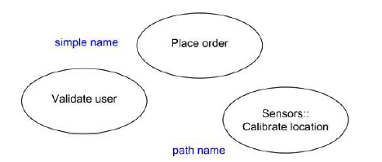
Names
A use case name must be unique within its enclosing package.
A simple name is a textual string.
A path name is the use case name prefixed by the name of the package in which that use case lives.

Slide 40
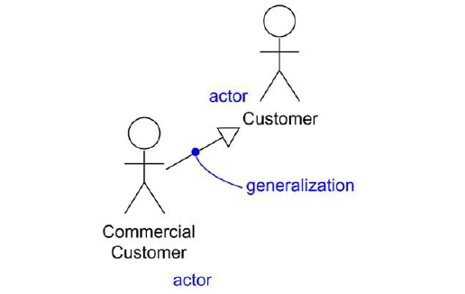
Actors are rendered as stick figures. You can define general kinds of
actors (such as Customer) and specialize them (such as Commercial Customer) using generalization relationships.

Slide 41
Use Cases and Flow of Events
A use case describes what a system (or a subsystem, class, or interface) does but it not specify how it does it.
When you model, it's important that you keep clear the separation of concerns between this outside and inside view.
You can specify the behavior of a use case by describing a flow of events in text clearly enough for an outsider to understand it easily.
When you write this flow of events, you should include how and when the use case starts and ends, when the use case interacts with the actors and what objects are exchanged, and the basic flow and alternative flows of the behavior.

Slide 42
Example of ATM Machine
Main flow of events:
The use case starts when the system prompts the Customer for a PIN number. The Customer can now enter a PIN number via the keypad. The Customer commits the entry by pressing the Enter button. The system then checks this PIN number to see if it is valid. If the PIN number is valid, the system acknowledges the entry, thus ending the use case.
Exceptional flow of events:
The Customer can cancel a transaction at any time by pressing the Cancel button, thus restarting the use case. No changes are made to the Customer's account.
Exceptional flow of events:
The Customer can clear a PIN number anytime before committing it and reenter a new PIN number.
Exceptional flow of events:
If the Customer enters an invalid PIN number, the use case restarts. If this happens three times in a row, the system cancels the entire transaction, preventing the Customer from interacting with the ATM for 60 seconds.

Slide 43
Use Cases and Scenarios
A use case actually describes a set of sequences in which each
sequence represents one possible flow through all the variations. Each sequence is called a scenario.
A scenario is a specific sequence of actions that illustrates behavior.
Scenarios are to use cases as instances are to classes, meaning that a scenario is basically one instance of a use case.
For example, in a human resources system, you might find the use case Hire employee. This general business function might have many possible
Variations:
---You might hire a person from another company (the most common scenario);
--- you might transfer a person from one division to another (common in international companies);
---You might hire a foreign national (which involves its own special rules). Each of these variants can be expressed in a different sequence.

Slide 44
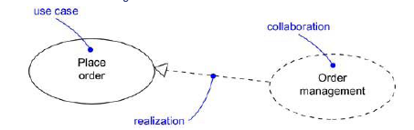
Use Cases and Collaborations
A use case captures the intended behavior of the system (or subsystem, class, or interface), without having to specify how that behavior is implemented.
However, to implement use cases, a society of classes and other elements that work together to implement the behavior of this use case are created.
This society of elements, including both its static and dynamic structure, is
modeled in the UML as a collaboration.
You can explicitly specify the realization of a use case by a collaboration.

Slide 45
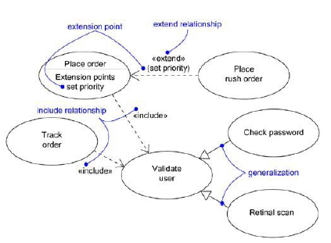
Organizing Use Cases

Slide 46
Include Relationship
An include relationship between use cases means that the base use case explicitly incorporates the behavior of another use case at a location specified in the base.
The included use case never stands alone, but is only instantiated as part of some larger base that includes it. You can think of include as the base use case pulling behavior from the supplier use case.
An include relationship can be used to avoid describing the same flow of events several times, by putting the common behavior in a use case of its own (the use case that is included by a base use case).
An include relationship is rendered as a dependency, stereotyped as include.
To specify the location in a flow of events in which the base use case includes the behavior of another, you simply write include followed by the name of the use case you want to include, as in the following flow for Track order.
Main flow of events:
Obtain and verify the order number. include (Validate user). For each part in the order, query its status, then report back to the user.

Slide 47
Extend Relationship
An extend relationship between use cases means that the base use case implicitly incorporates the behavior of another use case at a location specified indirectly by the extending use case. The base use case may stand alone, but under certain conditions, its behavior may be extended by the behavior of another use case. This base use case may be extended only at certain points called, extension points.
An extend relationship is used to model the optional system behavior.
An extend relationship is rendered as a dependency, stereotyped as extend. You may list the extension points of the base use case in an extra compartment.
For example, the flow for Place order might read as follows:
Main flow of events:
include (Validate user). Collect the user's order items. (set priority).
Submit the order for processing. In this example, set priority is an extension point.

Slide 48
Common Modeling Techniques
Applying use cases to elements in this way is important for three reasons:
It provides a way for domain experts to specify its outside view to a degree sufficient for developers to construct its inside view. Use cases provide a forum for your domain experts, end users, and developers to communicate to one another.
Use cases provide a way for developers to approach an element and understand it.
Use cases serve as the basis for testing each element as it evolves during development.

Slide 49
To model the behavior of an element,
Identify the actors that interact with the element. Candidate actors include groups that require certain behavior to perform their tasks or that are needed directly or indirectly to perform the element's functions.
Organize actors by identifying general and more specialized roles.
For each actor, consider the primary ways in which that actor interacts with the element.
Consider also interactions that change the state of the element or its environment or that involve a response to some event.
Consider also the exceptional ways in which each actor interacts with the element.
Organize these behaviors as use cases, applying include and extend relationships to factor common behavior and distinguish exceptional behavior.

Slide 50
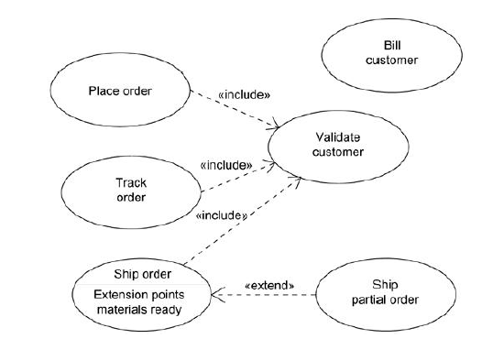
Example

Slide 51
UNIT-5
CHAPTER-17

Slide 52
Use Case Diagrams
Modeling the context of a system
Use case diagrams are important for visualizing, specifying, and documenting the behavior of an element.
Modeling the requirements of a system
They make systems, subsystems, and classes approachable and understandable by presenting an outside view of how those elements may be used in context.
Forward and reverse engineering
Use case diagrams are also important for testing executable systems through forward engineering and for comprehending executable systems through reverse engineering.

Slide 53
Terms and Concepts
A use case diagram is a diagram that shows a set of use cases and actors and their relationships.
A use case diagram is just a special kind of diagram and shares the same common properties as do all other diagrams• a name and graphical contents that are a projection into a model.
Use case diagrams commonly contain
· Use cases
· Actors
· Dependency, generalization, and association relationships
Like all other diagrams, use case diagrams may contain notes and constraints.

Slide 54
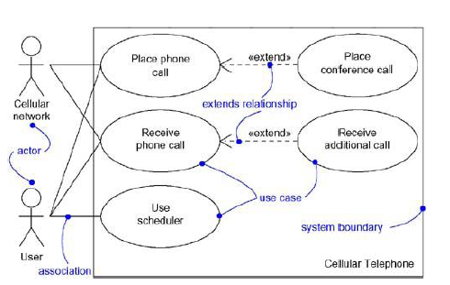
Example

Slide 55
When you model the static use case view of a system, you apply use case diagrams in one of two ways.
1. To model the context of a system Modeling the context of a system involves drawing a line around the whole system and asserting which actors lie outside the system and interact with it.
2. To model the requirements of a system Modeling the requirements of a system involves specifying what that system should do (from a
point of view of outside the system), independent of how that system should do it.
A usecase diagram lets you view the whole system as a black box.

Slide 56
Modeling the Context of a System
To model the context of a system,
Identify the actors that surround the system by considering which groups require help from the system to perform their tasks; which groups are needed to execute the system's functions; which groups interact with external hardware or other software systems; and which groups perform secondary functions for administration and maintenance.
Organize actors that are similar to one another in a generalization/specialization hierarchy.
Where it aids understandability, provide a stereotype for each such actor.
Populate a use case diagram with these actors and specify the paths of communication from each actor to the system's use cases.

Slide 57
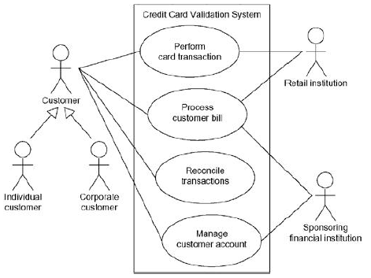
Example

Slide 58
Modeling the Requirements of a System
To model the requirements of a system,
Establish the context of the system by identifying the actors that surround it.
For each actor, consider the behavior that each expects or requires the system to provide.
Name these common behaviors as use cases.
Factor common behavior into new use cases that are used by others; factor variant behavior into new use cases that extend more main line flows.
Model these use cases, actors, and their relationships in a use case diagram.
Adorn these use cases with notes that assert nonfunctional requirements; you may have to attach some of these to the whole system.

Slide 59
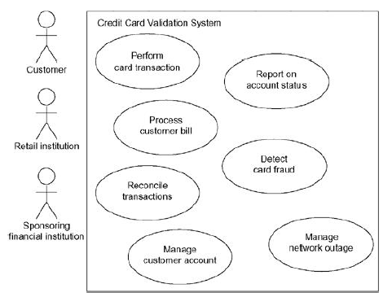
Example

Slide 60
Forward and Reverse Engineering
Most of the UML's diagrams, including class, component, and statechart diagrams, are clear candidates for forward and reverse engineering because each has an analog in the executable system.
Use case diagrams are a bit different : Use cases describe how an element
behaves, not how that behavior is implemented, so it cannot be directly forward or reverse engineered.
Forward engineering is the process of transforming a model into code through a mapping to an implementation language. A use case diagram can be forward engineered to form tests for the element to which it applies.
Reverse engineering is the process of transforming code into a model through a mapping from a specific implementation language.
Automatically reverse engineering a use case diagram is pretty much beyond the state of the art, simply because there is a loss of information when moving from a specification of how an element behaves to how it is implemented.

Slide 61
To forward engineer a use case diagram,
For each use case in the diagram, identify its flow of events and its exceptional flow of events.
Depending on how deeply you choose to test, generate a test script for each flow, using the flow's preconditions as the test's initial state and its post conditions as its success criteria.
As necessary, generate test scaffolding to represent each actor that interacts with the use case. Actors that push information to the element or are acted on by the element may either be simulated or substituted by its real-world equivalent.
Use tools to run these test each time you release the element to which the use case diagram applies.

Slide 62
To reverse engineer a use case diagram,
Identify each actor that interacts with the system.
For each actor, consider the manner in which that actor interacts with the system, changes the state of the system or its environment, or responds to some event.
Trace the flow of events in the executable system relative to each actor. Start with primary flows and only later consider alternative paths.
Cluster related flows by declaring a corresponding use case. Consider modeling variants using extend relationships, and consider modeling common flows by applying include
relationships.
Render these actors and use cases in a use case diagram, and establish their relationships.

Slide 63
UNIT-5
CHAPTER-19

Slide 64
Activity Diagrams
Modeling a workflow
Modeling an operation
Forward and reverse engineering

Slide 65
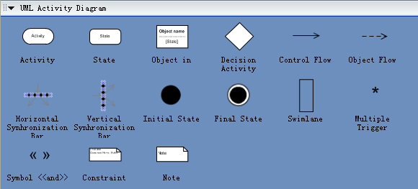

Slide 66
ACTIVITY DIAGRAM
Activity diagrams are used to model the dynamic aspects of a system.
It involves modeling the sequential (and possibly concurrent) steps in a computational process.
With an activity diagram, you can also model the flow of an object as it moves from state to state at different points in the flow of control.
Activity diagrams may stand alone to visualize, specify, construct, and document the dynamics of a society of objects, or they may be used to model the flow of control of an operation.
Whereas interaction diagrams emphasize the flow of control from
object to object, activity diagrams emphasize the flow of control from activity to activity.
An activity is an ongoing nonatomic execution within a state machine.
Activities ultimately result in some action, which is made up of executable atomic computations that results in a change in state of the system or the return of a value.
Activity diagrams are not only important for modeling the dynamic aspects of a system, but also for constructing executable systems through forward and reverse engineering

Slide 67
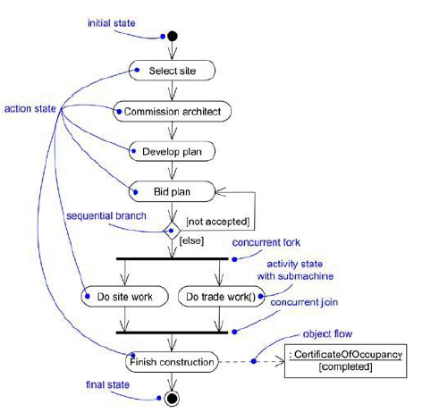

Slide 68
Terms and Concepts
An activity diagram shows the flow from activity to activity.
It is an ongoing nonatomic execution within a state machine.
Activities ultimately result in some action, which is made up of executable
atomic computations that result in a change in state of the system or the return of a value.
Actions encompass calling another operation, sending a signal, creating or destroying an object, or some pure computation, such as evaluating an expression.
Graphically, an activity diagram is a collection of vertices and arcs.
Activity diagrams commonly contain
· Activity states and action states
· Transitions
· Objects

Slide 69
Action States and Activity States
In the flow of control modeled by an activity diagram, things happen. You might evaluate some expression that sets the value of an attribute or that returns some value.
Alternately, you might call an operation on an object, send a signal to an object, or even create or destroy an object.
These executable, atomic computations are called action states because they are states of the system, each representing the execution of an action.

Slide 70
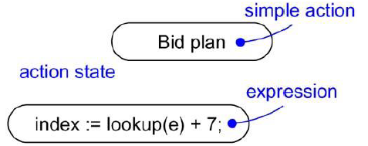

Slide 71
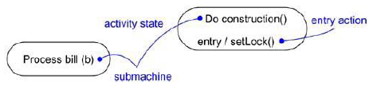
In contrast, activity states can be further decomposed, their activity being represented by other activity diagrams.
Furthermore, activity states are not atomic, meaning that they may be
interrupted and, in general, are considered to take some duration to complete.
An action state as a special case of an activity state. An action state is an activity state that cannot be further decomposed.
Similarly, you can think of an activity state as a composite, whose
flow of control is made up of other activity states and action states.
Zoom into the details of an activity state, and you'll find another activity diagram.
There's no notational distinction between action and activity states, except that an activity state may have additional parts, such as entry and exit actions (actions which are involved on entering and leaving the state, respectively) and submachine specifications.

Slide 72
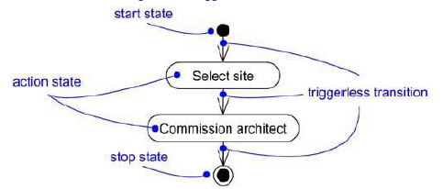
Triggerless transitions
Triggerless transitions may have guard conditions, meaning that such a transition will fire only if that condition is met.
When the action or activity of a state completes, flow of control passes immediately to the next action or activity state.

Slide 73
Branching
,
Branches are a notational convenience, semantically equivalent to multiple transitions with Guards.
Simple, sequential transitions are common, but they aren't the only kind of path you'll need to model a flow of control. As in a flowchart, you can include a branch, which specifies alternate paths taken based on some Boolean expression.
A branch may have one incoming transition and two or more outgoing ones. On each outgoing transition, you place a Boolean expression, which is evaluated only once on entering the branch.
Across all these outgoing transitions, guards should not overlap (otherwise,the flow of control would be ambiguous), but they should cover all possibilities (otherwise, the flow of control would freeze).
As a convenience, you can use the keyword else to mark one outgoing transition, representing the path taken if no other guard expression evaluates to true.
Branching and iteration are possible in interaction diagrams.

Slide 74
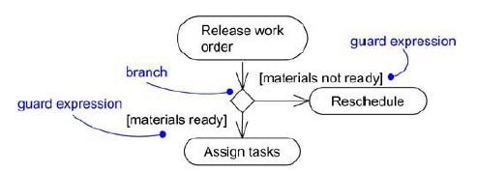

Slide 75
Forking and Joining
Each concurrent flow of control lives in the context of an independent active object, which is typically modeled as either a process or a thread.
Simple and branching sequential transitions are the most common paths you'll find in activity diagrams.
In the UML, you use a synchronization bar to specify the forking and joining of these parallel flows of control. A synchronization bar is rendered as a thick horizontal or vertical line.
A fork may have one incoming transition and two or more outgoing transitions, each of which represents an independent flow of control. Below the fork, the activities associated with each of these paths continues in parallel.
Conceptually, the activities of each of these flows are truly concurrent, although, in a running system, these flows may be either truly concurrent (in the case of a system
deployed across multiple nodes) or sequential yet interleaved (in the case of a system deployed
across one node), thus giving only the illusion of true concurrency.

Slide 76
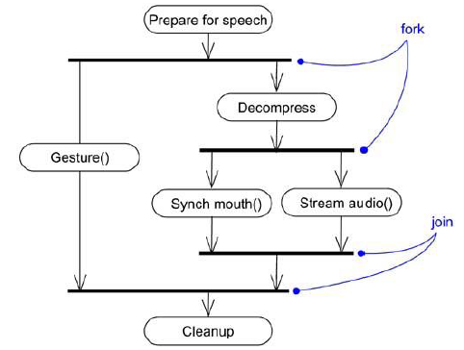

Slide 77
SWIMLANES
A swimlane is a kind of package
Each swimlane has a name unique within its diagram. A swimlane really has no deep semantics, except that it may represent some real-world entity.
Each swimlane represents a high-level responsibility for part of the overall activity of an activity diagram, and each swimlane may eventually be implemented by one or more classes.
In an activity diagram partitioned into swimlanes, every activity belongs to exactly one swimlane, but transitions may cross lanes.

Slide 78
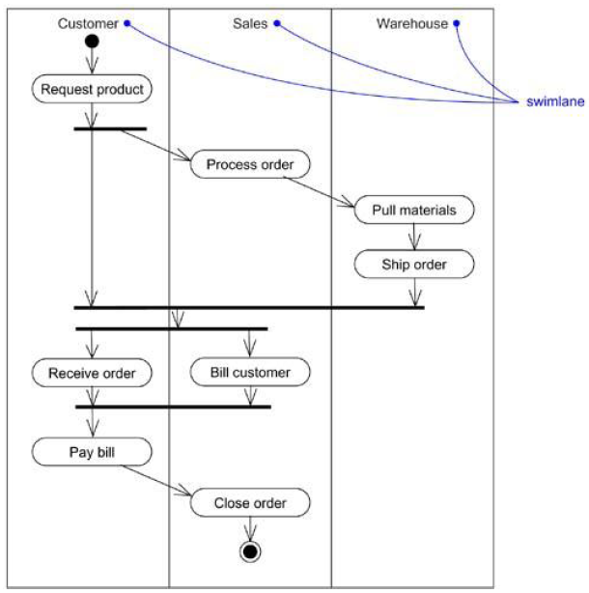

Slide 79
Object Flows
Objects may be involved in the flow of control associated with an activity diagram.
For example, in the workflow of processing an order as in the previous figure, the vocabulary of your problem space will also include such classes as Order and Bill. Instances of these two classes will be produced by certain activities (Process order will create an Order object, for example);
Other activities may modify these objects (for example, Ship order will change the state of the Order object to filled).
The things that are involved in an activity diagram, connected using a dependency to the activity or transition that creates, destroys, or modifies them are specified.
This use of dependency relationships and objects is called an object flow because it represents the participation of an object in a flow of control.

Slide 80
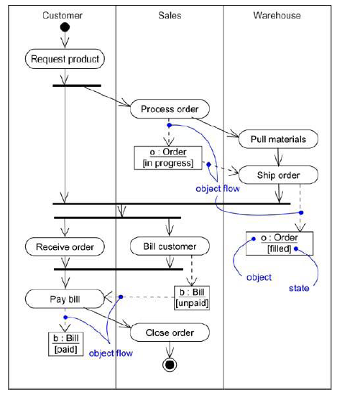

Slide 81
When you model the dynamic aspects of a system, you'll typically use activity diagrams in two ways.
To model a workflow
The activities as viewed by the actors that collaborate with the system are focused.
Workflows often lie on the fringe of software-intensive systems and are used to visualize, specify, construct, and document business processes that involve the system under development.
Hence, modeling object flow is particularly important.
2. To model an operation
Here activity diagrams are used as flowcharts, to model the details of a computation.
In this use of activity diagrams, the modeling of branch, fork, and join states is particularly important.
The context of an activity diagram used in this way involves the parameters of the operation and its local objects.

Slide 82
Modeling a Workflow
No software-intensive system exists in isolation; there's a context in which a system lives, and that context always encompasses actors that interact with the system.
Especially for mission critical, enterprise software, automated systems work in the context of higher-level business processes.
These business processes are kinds of workflows because they
represent the flow of work and objects through the business.

Slide 83
To model a workflow,
Establish a focus for the workflow. For nontrivial systems, it's impossible to show all interesting workflows in one diagram.
Select the business objects that have the high-level responsibilities for parts of the overall workflow. These may be real things from the vocabulary of the system, or they may be more abstract. In either case, create a swimlane for each important business object.
Identify the preconditions of the workflow's initial state and the postconditions of the workflow's final state. This is important in helping you model the boundaries of the workflow.
Beginning at the workflow's initial state, specify the activities and actions that take place over time and render them in the activity diagram as either activity states or action states.
For complicated actions, or for sets of actions that appear multiple times, collapse these into activity states, and provide a separate activity diagram that expands on each.
Render the transitions that connect these activity and action states. Start with the
sequential flows in the workflow first, next consider branching, and only then consider forking and joining.
If there are important objects that are involved in the workflow, render them in the activity diagram, as well. Show their changing values and state as necessary to communicate the intent of the object flow.

Slide 84
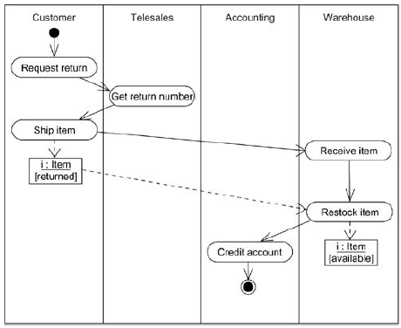
Example

Slide 85
Modeling an Operation
An activity diagram can be attached to any modeling element for the purpose of visualizing, specifying, constructing, and documenting that element's behavior.
Activity diagrams can be attached to classes, interfaces, components, nodes, use cases, and collaborations.
The most common element to which is attached to an activity diagram is an operation.
An activity diagram is simply a flowchart of an operation's actions.
It’s primary advantage is that all the elements in the diagram are semantically tied to a rich underlying model.
For example, any other operation or signal that an action state
references can be type checked against the class of the target object.

Slide 86
To model an operation,
Collect the abstractions that are involved in this operation. This includes the operation's parameters (including its return type, if any), the attributes of the enclosing class, and certain neighboring classes.
Identify the preconditions at the operation's initial state and the postconditions at the operation's final state. Also identify any invariants of the enclosing class that must hold during the execution of the operation.
Beginning at the operation's initial state, specify the activities and actions that take place over time and render them in the activity diagram as either activity states or action states.
Use branching as necessary to specify conditional paths and iteration.
Only if this operation is owned by an active class, use forking and joining as necessary to specify parallel flows of control.

Slide 87
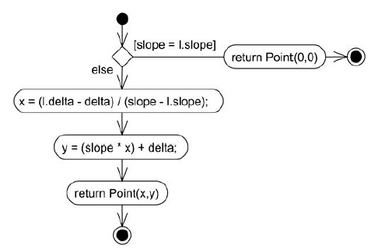
Example

Slide 88
Forward and Reverse Engineering
Forward engineering (the creation of code from a model) is possible for activity diagrams, especially if the context of the diagram is an operation.
For example, using the previous activity diagram, a forward engineering tool could generate the following C++ code for the operation intersection.
Point Line::intersection (l : Line) {
if (slope == l.slope) return Point(0,0);
int x = (l.delta - delta) / (slope - l.slope);
int y = (slope * x) + delta;
return Point(x, y);
}
There's a bit of cleverness here, involving the declarationof the two local variables. A less sophisticated tool might have first declared the two variables and then set their values.

Slide 89
Reverse Engineering
Reverse engineering (the creation of a model from code) is also possible for activity diagrams, especially if the context of the code is the body of an operation.
In particular, the previous diagram could have been generated from the implementation of the class Line.
More interesting than the reverse engineering of a model from code is the animation of a model against the execution of a deployed system.
For example, given the previous diagram, a tool could animate the action states in the diagram as they were dispatched in a running system.
Even better, with this tool also under the control of a debugger, the speed of execution can be controlled, possibly by setting breakpoints to stop the action at interesting points in time to examine the attribute values of individual objects.

Slide 90
Customer
Telesales
Accounting
Warehouse
Request
Return
Get Return
Number
Ship Item
Receive
Item
Item
[returned]
Restock
Item
Credit
Item
Account
[available]

